Slide 1
Daily Review
Scientists use symbols to represent the names of different elements.
Element symbols consist of one or two letters. The first letter is always a capital, and if there is a second letter it is always in lower case.
What is wrong with each of the symbols below?
Aluminium: AL
Nickel: Nic
Carbon: c

Slide 2
Daily Review
Scientists use symbols to represent the names of different elements.
Most element symbols match the first and second letters of the element name.
Think, pair, share: What are the symbols for the elements below?
Hydrogen
Carbon
Iodine
Neon
Calcium

Slide 3
Daily Review
Scientists use symbols to represent the names of different elements.
Some element symbols match the first letter, but the second letter is taken from another part of the element name.
Think, pair, share: What is the name for the elements with the symbols below?
Mg
Zn
Cl

Slide 4
Daily Review
Scientists use symbols to represent the names of different elements.
Some element symbols don’t match the element name at all. These symbols have been taken from the name of the element in another language, for example Latin.
Think, pair, share: What is the name for the elements with the symbols below?
Na
Fe
Cu
Au
Pb

Slide 5
Atomic Structure Year 9 Chemistry

Slide 6
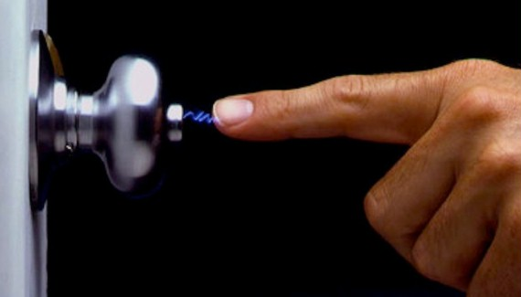
Learning Objectives
CFU
What are we going to learn?
Describe the structure of atoms in terms of the three subatomic particles.
Identify and explain the difference between neutral and charge atoms.
Activate Prior Knowledge
When you experience a small shock from “static electricity”, it is because an electric charge has built up on an object, through the movement of electrons.
Think-pair-share: What is the charge on an electron? What is the other type of charged particle, and what is its charge?

Slide 7
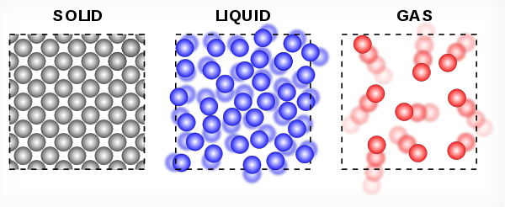
Concept Development
CFU 1
What is the definition of matter?
Matter
Matter is any substance that has mass and volume.
Matter can take many forms, including:
Solids – for example your chair
Liquids – for example water
Gases – for example oxygen
Matter is composed of tiny particles called atoms.
Atoms are usually represented as small, individual circles in diagrams.
However, atoms are themselves composed of even smaller parts, referred to as subatomic particles.
CFU 2
On your whiteboard, list three other examples of solids, liquids and gases.
CFU 3
What does the phrase “subatomic particle” mean?
Vocabulary
Subatomic: smaller than, or occurring within, an atom

Slide 8
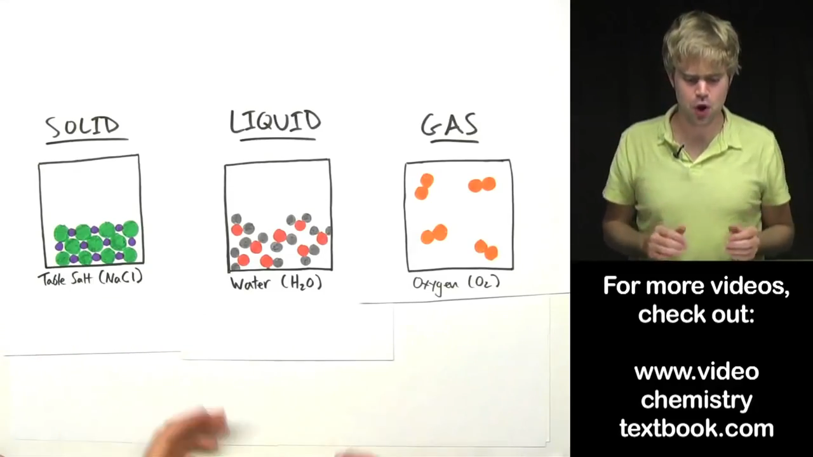

Slide 9
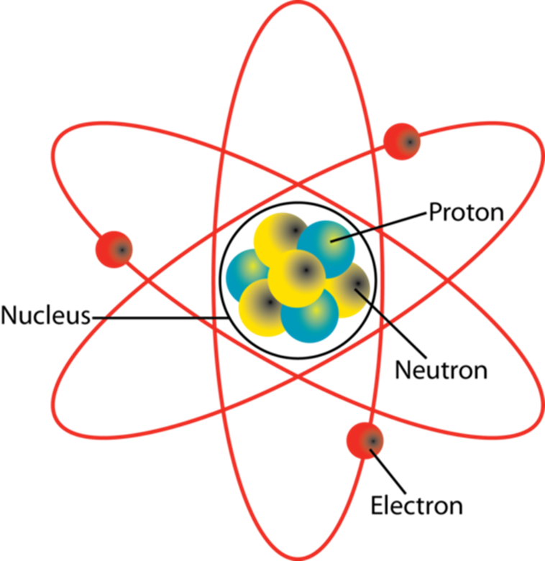
Concept Development
CFU 1
Which subatomic particles are found in the nucleus?
CFU 2
Which subatomic particles are negatively charged?
Structure of an Atom
Atoms are made of three subatomic
particles: protons, neutrons and electrons.
Protons and neutrons are found in the centre of an atom, which is called the nucleus.
Electrons orbit the nucleus at very high speeds.
Some subatomic particles have electrical charges:
Protons have a positive (+) charge
Electrons have a negative (-) charge
Neutrons are neutral and have no charge
CFU 3
How are protons and electrons different to neutrons?
CFU 4
How are protons and neutrons different to electrons?
Vocabulary
Subatomic: smaller than, or occurring within, an atom

Slide 10
Concept Development
CFU 1
What determines which type of element an atom is?
Structure of an Atom
The number of protons in the nucleus of an atom determines which element the atom is.
All atoms of an element have the same number of protons.
For example, all carbon atoms have 6 protons.
This is referred to as the atomic number of the element.
CFU 2
An element has an atomic number of 16. How many protons are in its nucleus?
CFU 3
What is the atomic number of the atom in the picture? How do you know.
Vocabulary
Subatomic: smaller than, or occurring within, an atom

Slide 11
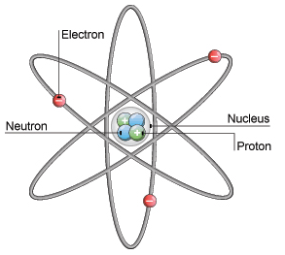
Concept Development
CFU 1
If a neutral atom has 11 electrons, how many protons does it have?
Structure of an Atom
A neutral atom has the same number of protons as electrons.
This means that the number of positive charges equals the number of negative charges.
The charges balance each other, so the entire atom has no charge.
For example, the atom in the picture has three positive protons and three negative electrons, so it has no overall charge.
CFU 2
Why does a neutral atom have no charge?
CFU 3
Is the atom shown at the bottom of the slide a neutral atom? Explain your choice.
Vocabulary
Subatomic: smaller than, or occurring within, an atom

Slide 12
Skill Development/Guided Practice
CFU 1
How many protons and neutrons are in the nucleus?
CFU 2
How many electrons are orbiting the nucleus?
Describing the Structure of an Atom
State the number of protons and neutrons in the nucleus. State the number of electrons orbiting the nucleus. State whether the atom is neutral or charged. neutral = number of protons and electrons is equal charged = number of protons and electrons is not equal
CFU 3
Is the atom neutral or charged?
Describe the structure of the lithium atom.
There are 3 protons and 4 neutrons in the nucleus.
There are 3 electrons orbiting the nucleus.
The atom is neutral because the number of protons and electrons is equal.

Slide 13
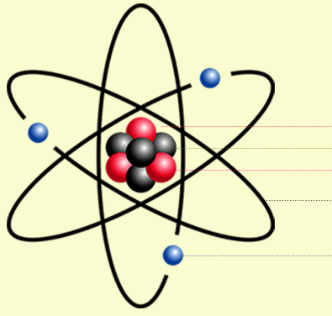
Skill Development/Guided Practice
CFU 1
How many protons and neutrons are in the nucleus?
CFU 2
How many electrons are orbiting the nucleus?
Describing the Structure of an Atom
State the number of protons and neutrons in the nucleus. State the number of electrons orbiting the nucleus. State whether the atom is neutral or charged. neutral = number of protons and electrons is equal charged = number of protons and electrons is not equal
CFU 3
Is the atom neutral or charged?
Describe the structure of the beryllium atom.
There are 4 protons and 3 neutrons in the nucleus.
There are 3 electrons orbiting the nucleus.
The atom is charged because the number of protons and electrons is not equal.
Proton
Neutron
Electron

Slide 14
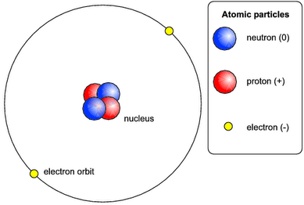
Skill Development/Guided Practice
CFU 1
How many protons and neutrons are in the nucleus?
CFU 2
How many electrons are orbiting the nucleus?
Describing the Structure of an Atom
State the number of protons and neutrons in the nucleus. State the number of electrons orbiting the nucleus. State whether the atom is neutral or charged. neutral = number of protons and electrons is equal charged = number of protons and electrons is not equal
CFU 3
Is the atom neutral or charged?
Describe the structure of the helium atom.
There are 2 protons and 2 neutrons in the nucleus.
There are 2 electrons orbiting the nucleus.
The atom is neutral because the number of protons and electrons is equal.

Slide 15
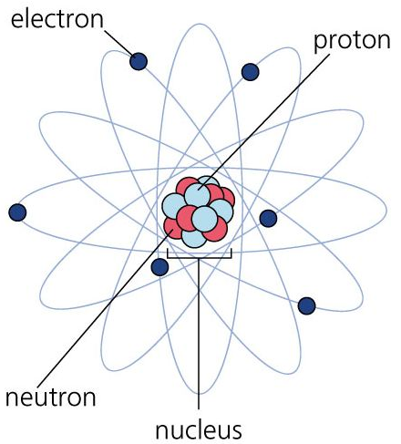
Skill Development/Guided Practice
CFU 1
How many protons and neutrons are in the nucleus?
CFU 2
How many electrons are orbiting the nucleus?
Describing the Structure of an Atom
State the number of protons and neutrons in the nucleus. State the number of electrons orbiting the nucleus. State whether the atom is neutral or charged. neutral = number of protons and electrons is equal charged = number of protons and electrons is not equal
CFU 3
Is the atom neutral or charged?
Describe the structure of the carbon atom.
There are ___ protons and ___ neutrons in the nucleus.
There are ___ electrons orbiting the nucleus.
The atom is ________ because __________.

Slide 16
Skill Development/Guided Practice
CFU 1
How many protons and neutrons are in the nucleus?
CFU 2
How many electrons are orbiting the nucleus?
Describing the Structure of an Atom
State the number of protons and neutrons in the nucleus. State the number of electrons orbiting the nucleus. State whether the atom is neutral or charged. neutral = number of protons and electrons is equal charged = number of protons and electrons is not equal
CFU 3
Is the atom neutral or charged?
Describe the structure of the helium atom.
There are ___ protons and ___ neutrons in the nucleus.
There are ___ electrons orbiting the nucleus.
The atom is ________ because __________.

Slide 17
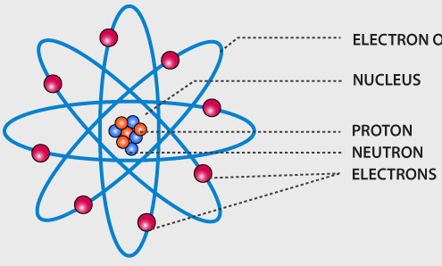
Skill Development/Guided Practice
CFU 1
How many protons and neutrons are in the nucleus?
CFU 2
How many electrons are orbiting the nucleus?
Describing the Structure of an Atom
State the number of protons and neutrons in the nucleus. State the number of electrons orbiting the nucleus. State whether the atom is neutral or charged. neutral = number of protons and electrons is equal charged = number of protons and electrons is not equal
CFU 3
Is the atom neutral or charged?
Describe the structure of the beryllium atom.
There are ___ protons and ___ neutrons in the nucleus.
There are ___ electrons orbiting the nucleus.
The atom is ________ because __________.

Slide 18
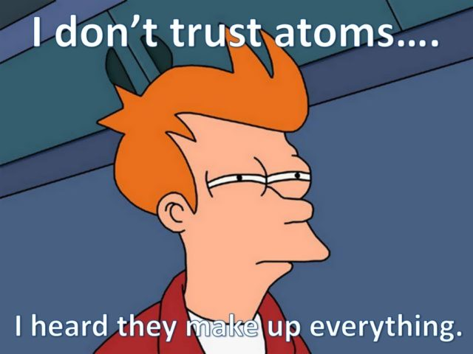
Relevance
Knowing the internal structure of atoms will help you understand how elements are defined by their atomic number.
It will also help you understand how and why elements interact with each other in predictable ways, and can combine to make many different substances.

Slide 19
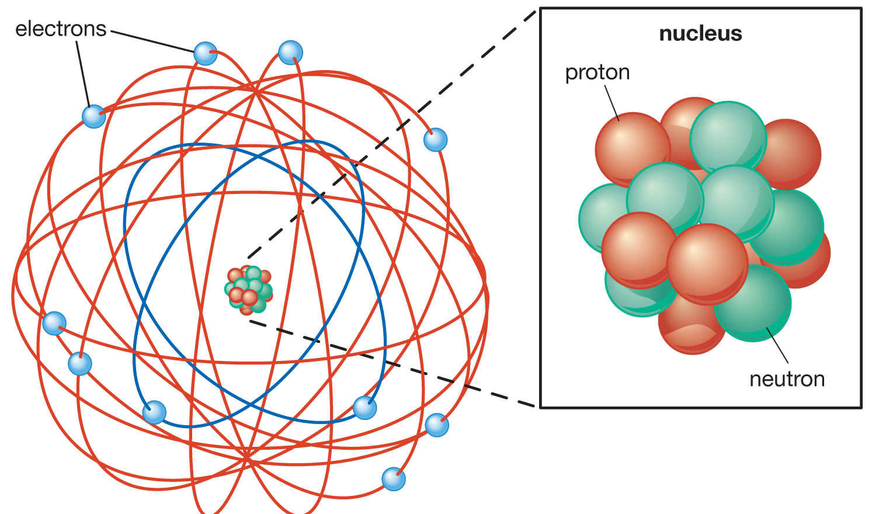
Skill Closure
Describing the Structure of an Atom
State the number of protons and neutrons in the nucleus. State the number of electrons orbiting the nucleus. State whether the atom is neutral or charged. neutral = number of protons and electrons is equal charged = number of protons and electrons is not equal
What are the three subatomic particles? What are their charges?
Skill Closure
If an atom is neutral, what does it say about the subatomic particles in the atom?
Skill Closure
Describe the structure of the fluorine atom.

Slide 20
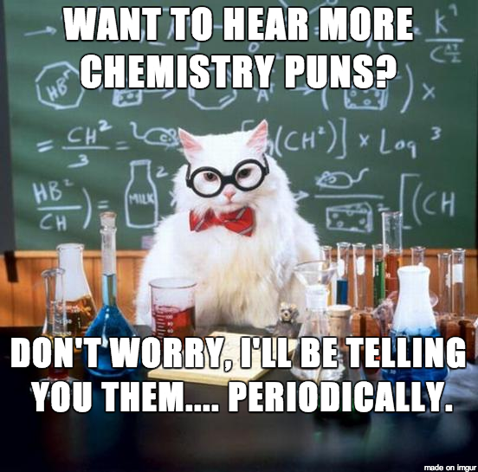
Independent Practice
Complete the “Structure of an Atom” worksheet on connect or paper copy.

